Slide 1
Flexible batteries for wearable devices
Dhairya Arora Reva Teotia Sarthak Dixit

Slide 2
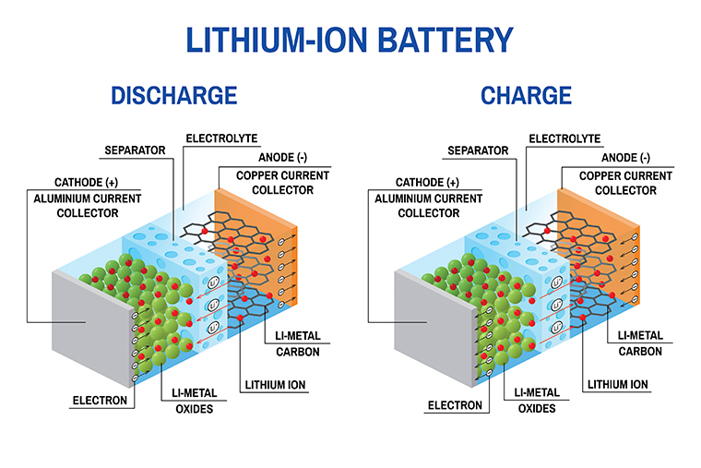
Batteries: General Concept
Current Collectors: Al, Cu
Electrodes: Metal oxides(positive terminal), Carbon(neg terminal)
Active material: Li₂O
Electrolyte: Lithium based gel or polymer
Separators: Polyethylene, Polypropylene

Slide 3
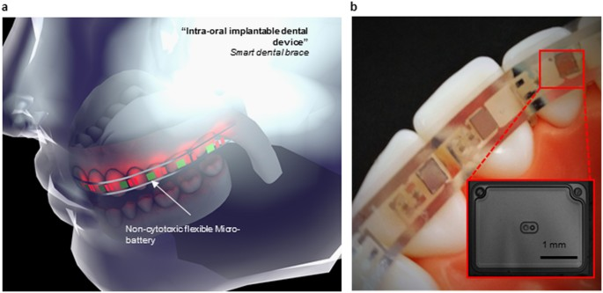
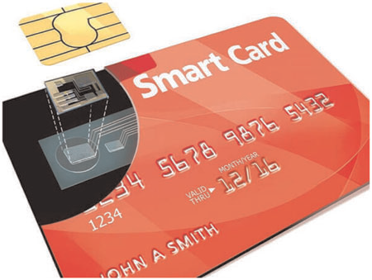
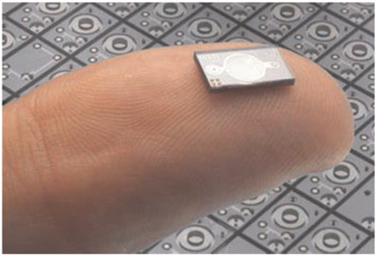
Flexible batteries: Need
Internet of things
Foldable displays
Wearable and Implantable devices
RFID tags

Slide 4
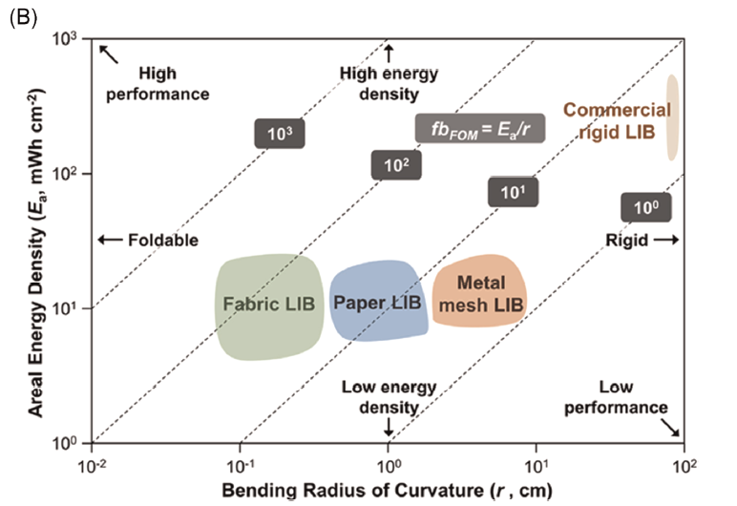
Flexible batteries: Desired Properties
High energy density, high flexibility, and dynamically stable power output should be achieved simultaneously in flexible batteries.
Mechanical properties: For flexible electronics minimum strain should be 5%.(by institute of printed electronics)
Energy Density: Energy density relates to the amount of energy that can be stored per battery unit. Standard Li-ion batteries have ED around 100-270Wh/kg.
Flexible batteries figure of merit(fbom): Volumetric energy density* strain.
fbFoM = Ea/r.
Ea = aerial energy density
R = bending radius

Slide 5
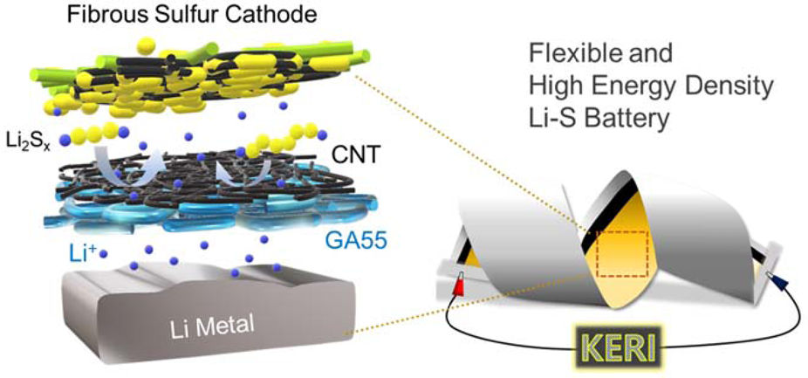
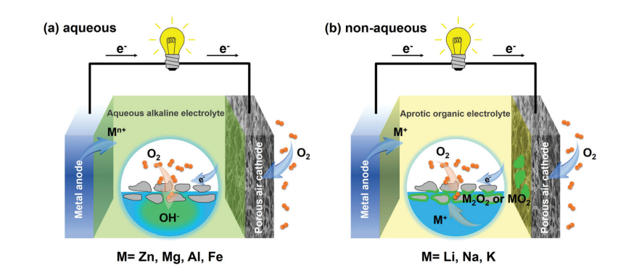
Technologies
Metal gas
Metal-CO₂
Metal O₂
Li ion
Li-S
Polymer based batteries

Slide 6
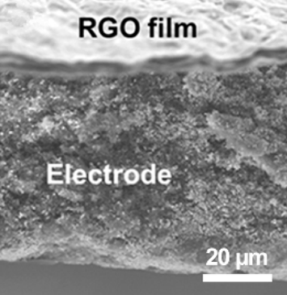
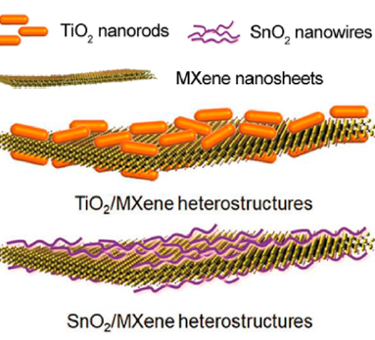
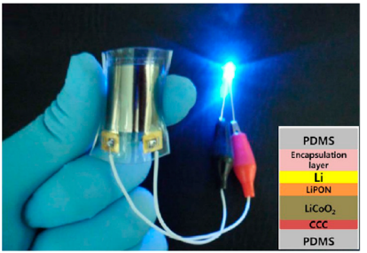
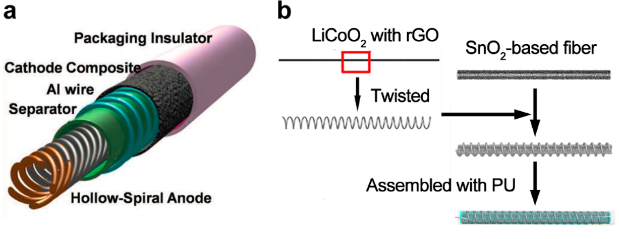
Li-Ion Batteries
How to make them flexible?
Using porous materials.
Superslim batteries
Structural & topological changes

Slide 7
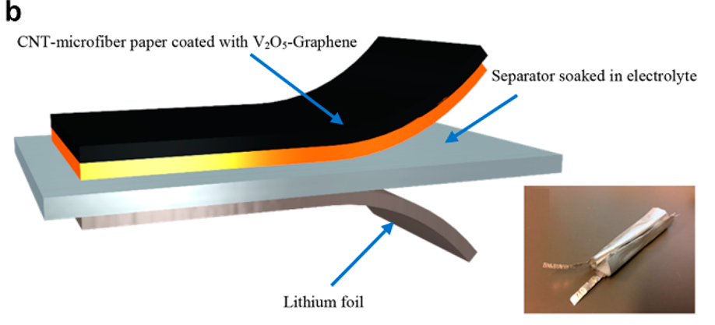
Porous Materials: Current collectors
Standard materials used: Al and Cu.
Materials:
Al and Cu: Can be made flexible but not used because of low yield strain(0.9 and 1.2% respectively).
Carbonaceous and Polymers: CNTs, Carbon Fibers, carbon cloth (CC),graphene,polyacrylonitrile (PAN), cellulose. High flexibility, extraordinary conductivity, light-weight and large surface area.
RGO: (in 2016), Highly porous, conductive film (>3112 S/cm). fabricated by a solution based filtration process followed by thermal reduction (773 K), and then a high temperature reduction (2750 K by Joule heating)
Fabricated by depositing single-wall CNTs over wood microfibers through a layer-by-layer self-assembly process.

Slide 8
Porous Materials: Electrodes
Standard materials used: Metal oxides and Carbon based
Materials:
The electrodes are usually fabricated/ selected in a way, that it can interact well with the current collectors. This helps to increase the adhesion stress and area. For eg. the composite cathode of the poly-compound (PDHBQS) interlocked with single-wall carbon nanotubes (SWCNTs) has been fabricated for flexible LIBs. (discharge capacity of 182 mAh/g at 50 mA/g).
TiO2 nanorods and SnO2 nanowires on MXene nanaosheets as porous anode for Li-ion batteries.
C Cloth with exfoliated porous Carbon shell(CC@EC) as CC. NiCo2O4 anode and LiNi1/3Co1/3Mn1/3O2 cathode are grown over CC@EC. Excellent properties of capacity retention after multiple bending cycles.
Some other porous materials include: Li Titanium oxide grown on Ti foil, porous LiCoO2 nanosheet array and porous LiMn2O4 nanosheets
The electrodes can be printed using common printing techniques: 3D, Aerosol gel, inkjet and stencil.

Slide 9
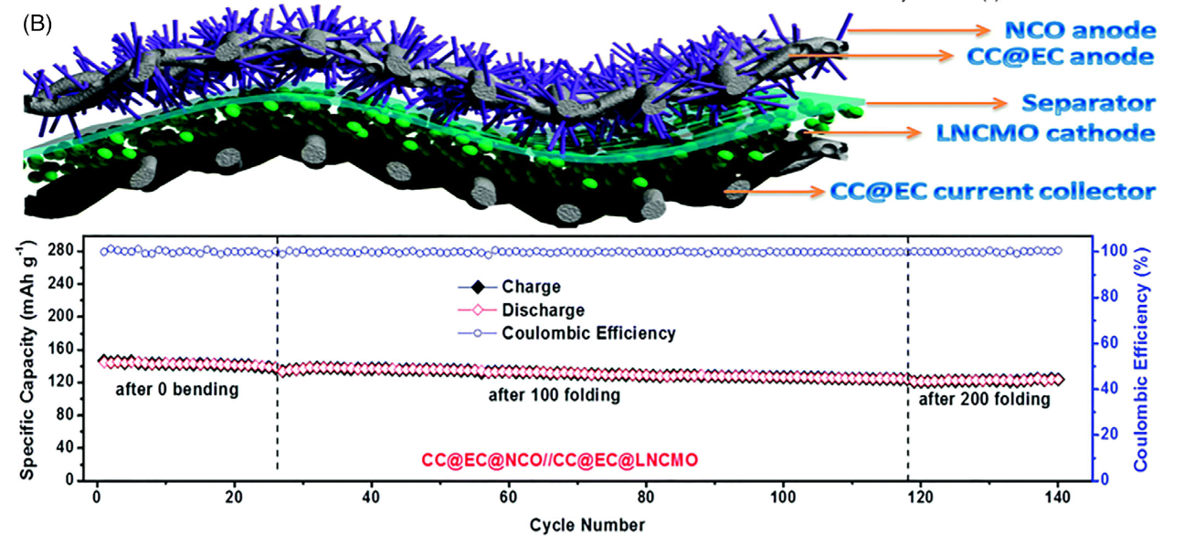
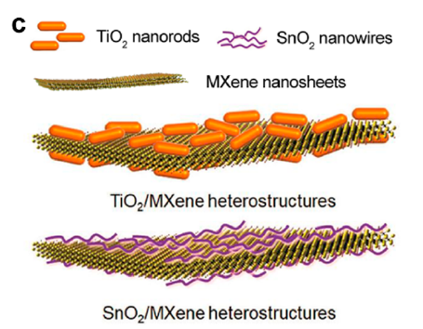
Porous Materials: Electrodes
FLIB with NiCo2O4 anode and LiNi1/3Co1/3Mn1/3O2 cathode on carbon cloth current collectors.
The monolithic CC@EC@NCO CDS architectures are fabricated by the thermal reduction and etching of the hydrothermally produced Ni(OH)2·H2O nanosheets

Slide 10
Porous Materials: Electrolytes
Standard materials used: Li based gels or polymers
Considerations: Solid vs Liquid electrolytes. Liq elec. Usually not used in flexible Li-ion batteries.
Materials:
GPEs(Gel Polymer electrolyte): Polyethylene oxide, Polyimide, poly(ethylcyanoacrylate), poly(vinylidene fluoride) (PVDF), poly(arylene ether),and poly(vinylidene fluoride-co-hexafluoropropylene) (PVDF-HFP)
SPEs(Solid-state polymer electrolytes): LLZO(Li7La3Zr2O12) and PEO based solid electrolyte : high ionic conductivity and flexibility, flexible CSE with vertically aligned columns of Li1+xAlxTi2−x(PO4)3 (LATP): good ionic conductivity and flexibility. Many other complex compounds can be used as an electrolyte while maintaining flexibility and good ionic conductivity.

Slide 11
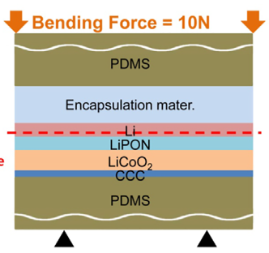
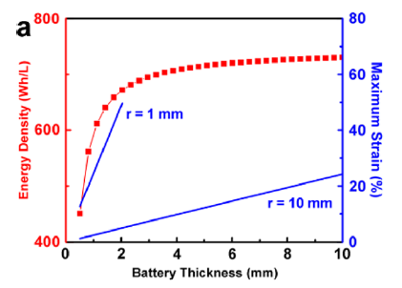
Superslim batteries
Technology: Thinning. Thin materials are used to make the batteries.
Strain = t/2r

Slide 12
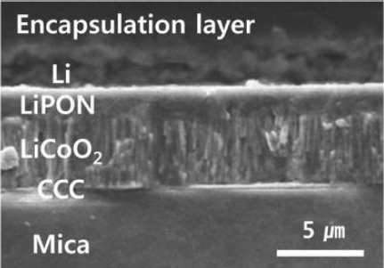
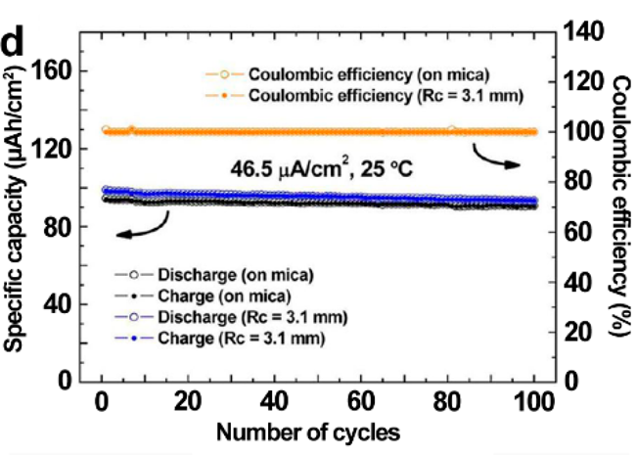
Superslim batteries: Materials
Substrate : PDMS/ Mica
Electrodes
Anode: Li metal
Cathode: Lithium cobalt oxide
Electrolyte: Lithium phosphorus oxynitride(LiPON)
Current collectors: Cathode current collector(CCC)
The same battery is also being manufactured with PDMS
Substrate on both the sides.
Some properties:
Capacity = 106 uAh/cm2
Capacity retention = 94.5% after 100 cycles

Slide 13
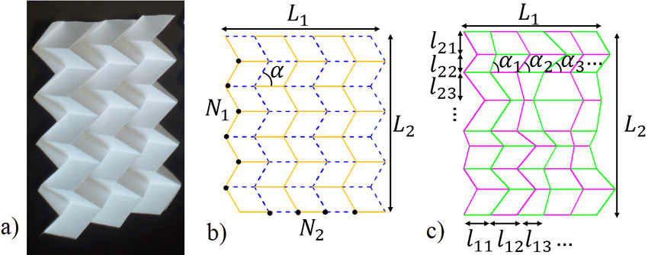
Topological batteries
Flexible batteries can also be realized by optimizing the structure of the cells.
Some of these structures include:
Wire-shaped
cable-type
Wave-like
miura pattern

Slide 14
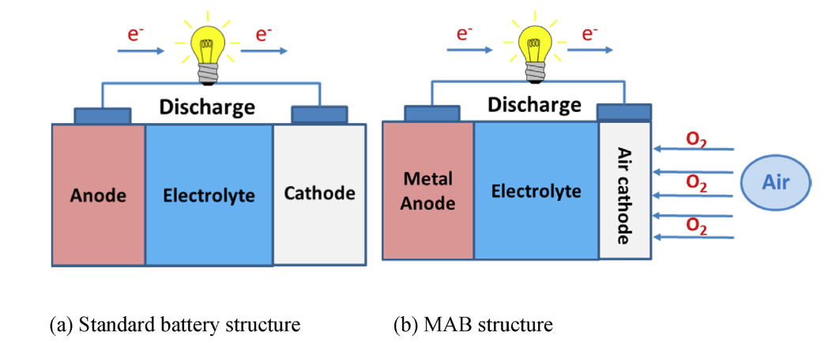
Metal Gas Batteries
The basic working principle of the battery relies on the chemical reaction between metal ions and gases available in the air such as O₂ and CO₂.
Significant advantages:
Excellent energy storage capacity
Reversibility of reaction
Sufficient service life
Challenges faced:
Sluggish reaction rates
Catalysis decay
Difficult quick charging
Structure

Slide 15
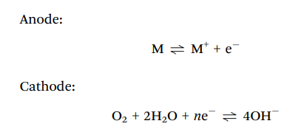
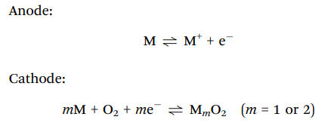
Metal-O₂ Batteries
Governing discharge equation (Aqueous):
Examples: Zinc-Air Batteries (ZAB), Li-O₂ Batteries
Governing discharge equation (Non-Aqueous):

Slide 16
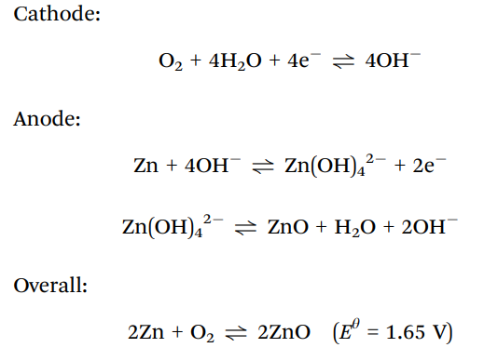
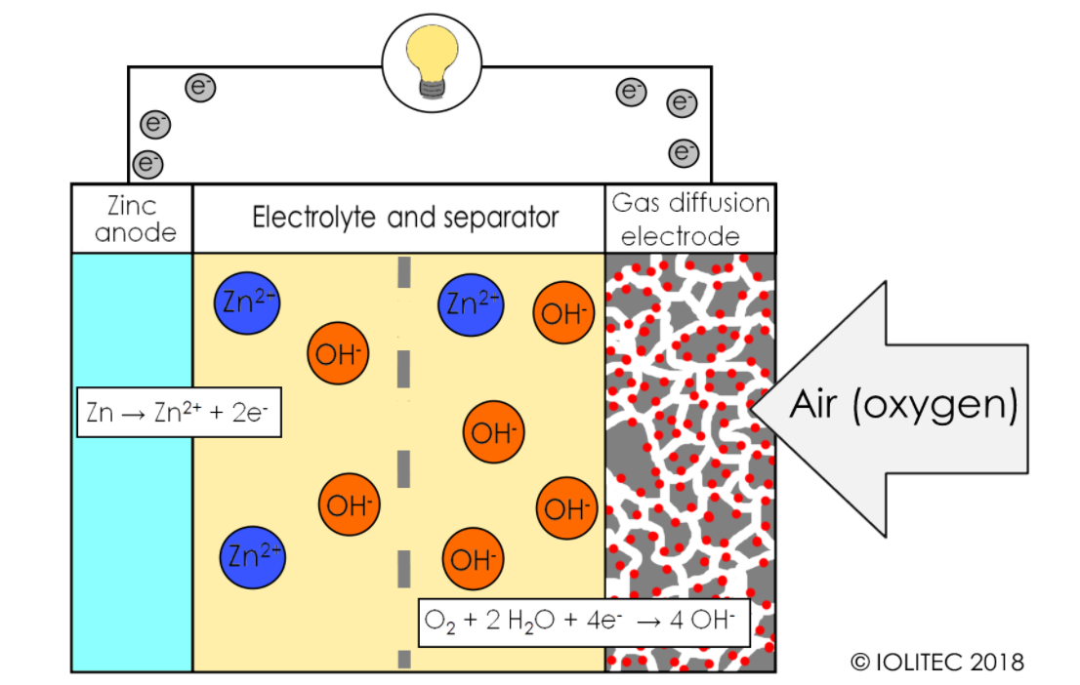
Metal-O₂ Batteries: Flexible ZAB
Governing Equation:
Only commercialized metal-gas battery → hearing aids
Energy density (theoretical) = 1084 W h kg-1
Equilibrium potential = 1.65 V

Slide 17
Metal-O₂ Batteries: Flexible ZAB
Flexible Air Cathodes:
Spraying Technique: Catalyst sprayed onto porous current collector
N-doped CNT/reduced graphene oxide (rGO) hybrid
Cross-stacked aligned CNT sheets dipped in RuO2 catalyst ink
Co atoms dispersed in coordination polymers
In-Situ Construction: Integration of catalyst and/or a current collector into free standing electrodes
Flexible carbon cloth with oxygen abundant functional groups (acid oxidation, air calcination)
Graphene hydrogel or B-doped graphene quantum dots (self assembly of rGO during hydrothermal process)
Flexible Zn Anodes:
Materials such as Zn foils or Zn wires used
Lower cost, simplified process
Good mech strength, flexibility, easy processing
Other options excessive (in terms of Zn quantity)
Challenges:
Low utilization of anode → low energy density
Pure Zn easily damaged (inherent metal fatigue)
Dendritic crystals → damage cell
Solutions derived from ZIBs:
Epitaxial deposition of Zn with proper crystal orientation
ZnF₂ rich SEI film on Zn anode (stable cycling performance)
Zn/CNT/CNF anodes (dendrite reduction)

Slide 18
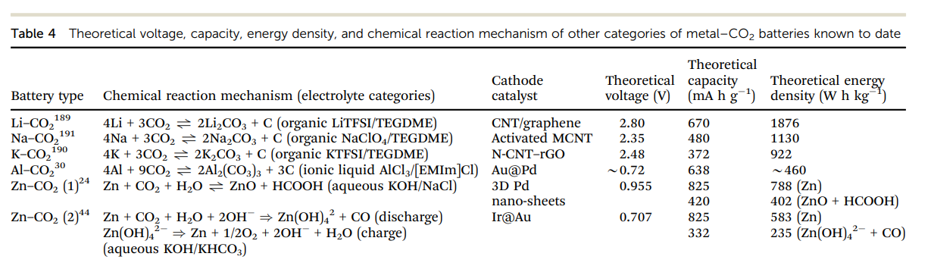
Metal-CO₂ Batteries
Promising candidate for next generation batteries
High energy density
CO₂ capture
Li-CO₂, K-CO₂, Na-CO₂, Al-CO₂, Zn-CO₂
Li-CO₂ most promising
Working Voltage → 2.8 V
Energy Density → 1875 W h kg -1

Slide 19
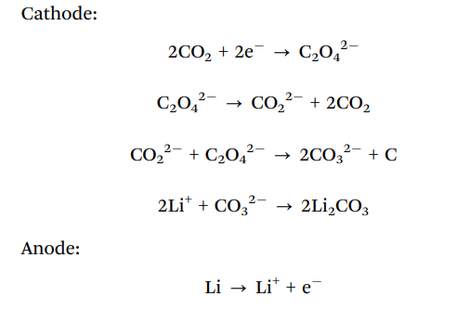
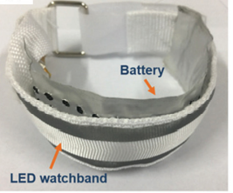
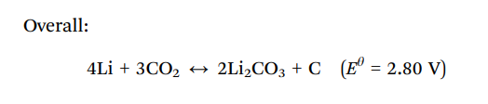
Metal-CO₂ Batteries: Li-CO₂
Flexible Air Cathodes:
For Planar Batteries:
N-doped carbon with MoFeNi and MoC nanocomposites on nickel foam
Ru/C-based cathode
Ir/C nanofiber networks
For Fiber Shaped Batteries:
N-doped CNTs networks anchored on Ti wires
Mo2C nanoparticles on CNT cloth hybrid films

Slide 20
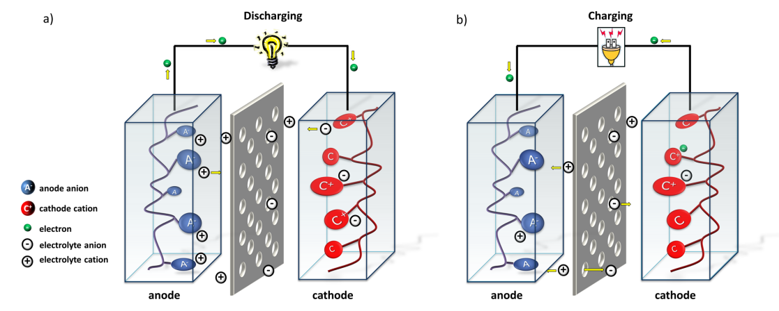
Polymer Based Batteries
Batteries that use organic redox-active polymers instead of metals for either electrode, cathode or anode are polymer-based batteries.
Advantages over Li-ion batteries -
Excellent rate performance
Very long cycle life
Sustainable and recyclable.
Polymer based batteries typically consist of
Electrodes
Active polymer
Conductive additive
Polymeric binder
Electrolyte/separator
Polymer based battery in dual ion-configuration

Slide 21
Active materials
Conjugated Polymers
Advantages - conductivity can be varied through doping
Disadvantages - i. slopping redox potential
ii. limited achievable level of doping
Examples -
Polypyrrole (PPy)
Polythiophene (PT)
Polyaniline (PANI)
Polyacetylene
Combination with inorganic redox active compounds
2. Nonconjugated conventional redox-active polymers
Advantages - non-conductive backbone therefore charge localized over redox sites
Disadvantages - low conductivity
Examples -
Carbonyl Compounds
Organosulfur Compounds
Carbazole
Organometallic ferrocene-based compounds

Slide 22
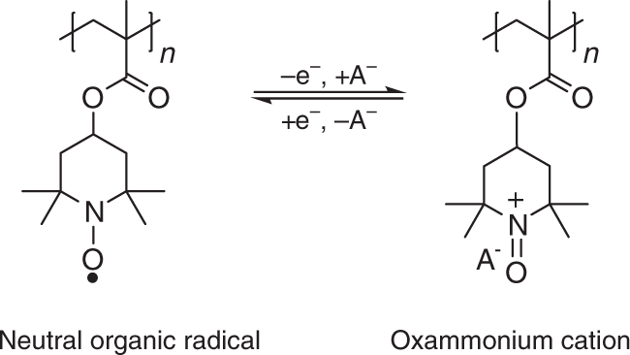
Radical batteries
Organic radical batteries are stable during operation but degradable at end of life.
PTMA (poly(2,2,6,6-tetramethylpiperidinyloxy-4-ylmethacrylate))
PTMA changes into gel like state due to absorption of organic electrolytes and hardly gets damaged when repeatedly gets bent and unbent.
Cross linked PTMA gel has the storage elastic modulus under 10kPa.
PTMA/vapor grown carbon fiber (VGCF) composite show excellent discharge rate properties (20C/1C capacity 91%).
Other examples -
2,2,6,6-Tetramethylpiperidinyl-N-oxyl (TEMPO)
Nitroxide Radicals
Galvinoxyl

Slide 23
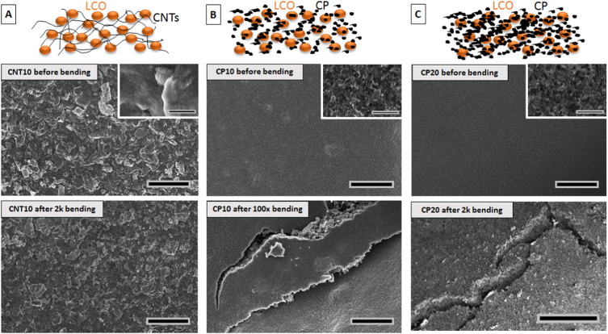
Conductive additive
Non conjugated polymers posses low conductivity therefore additional conductive additives are required.
Example -
Carbon powder
Vapor grown carbon fibers
Graphene or carbon nanotubes
Graphene or reduced graphene oxide
Work by Sarah et. al. shows that the absence of cracks in the CNT based electrodes suggests that the CNTs form an interconnected network that mechanically binds the active material.

Slide 24
Polymeric binders
Polymeric binders provide mechanical stability and provide good contact between current collector and composite electrodes.
2 to 10 wt % of a composite electrode consists of binders.
Example -
Carboxymethylcellulose
fluorinated polymers such as - PVDF(poly(vinylidene difluoride))
- PTFE (poly(tetrafluoroethylene))

Slide 25
References
S. Muench, A. Wild, C. Friebe, B. Häupler, T. Janoschka, U. S. Schubert, Chem. Rev. 2016, 116, 9438.
Hager, M. D., Esser, B., Feng, X., Schuhmann, W., Theato, P., & Schubert, U. S. (2020). Polymer-based batteries-flexible and thin energy storage systems. Advanced Materials (Deerfield Beach, Fla.), 32(39), e2000587. https://doi.org/10.1002/adma.202000587
Reduced Graphene Oxide Films with Ultrahigh Conductivity as Li-Ion Battery Current Collectors https://orcid.org/0000-0001-9829-1202
https://doi.org/10.1002/adma.201202196. Cable-type flexible lithium ion battery based on hollow multi-helix electrodes
A Figure of Merit for Flexible Batteries https://doi.org/10.1016/j.joule.2020.05.015
DOI: 10.1021/acsenergylett.8b02496 Designing Flexible Lithium-Ion Batteries by Structural Engineering
Development of flexible Li-ion batteries for flexible electronics. https://doi.org/10.1002/inf2.12117
Achieving high gravimetric energy density for flexible lithium-ion batteries facilitated by core–double-shell electrodes. https://doi.org/10.1039/C8EE00522B
Solvent-Engineered Scalable Production of Polysulfide-Blocking Shields to Enhance Practical Lithium–Sulfur Batteries
https://doi.org/10.1149/MA2018-03/2/129
https://doi.org/10.1016/j.msea.2018.08.033

Slide 26
Thank You

